Slide 1
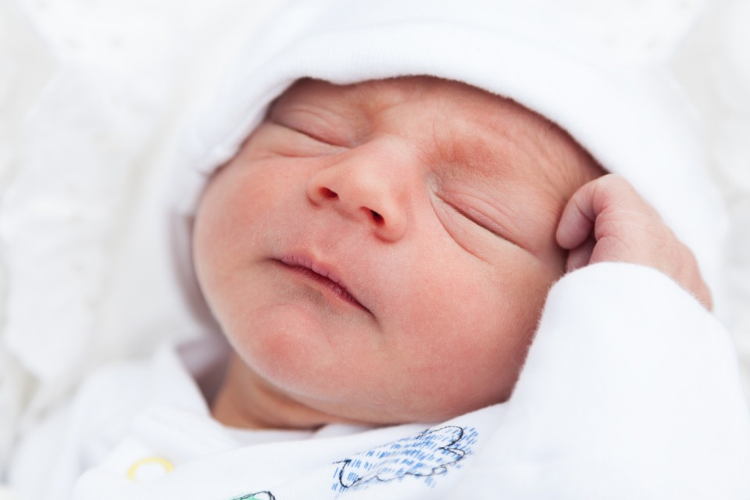
Spanish for Lactation Consultants
Three Ways to Be: Ser, Estar and Haber
By
Dorothy Potter Snyder
www.dorothypotterspanish.com

Slide 2
In Spanish There Are 3 Ways to Be
Those verbs are SER, ESTAR and HABER
They are all irregular conjugations
Roughly speaking
SER is about essence and characteristics.
ESTAR is about feelings and location.
HABER is about general existence.

Slide 3

This is different from English.
English only has one verb “to be”.
Spanish is not English in translation.
What does that
mean to me?
Spanish has its own logic.
We can not translate word-for-word.

Slide 4
#1 Way to Be - SER
To be or...to be? That IS the question when speaking Spanish.
Let's conjugate the verb SER together:
Yo soy (I am)
Tú eres (You informal are)
Él, Ella, Usted es (He, She, You formal are)
Nosotros/as somos (We are)
Ellos/as, ustedes son (They, you all are)
Hint: Conjugate SER many times until you can do it without looking! Conjugate with and without subject pronouns.

Slide 5
When to Use SER
Identity / Job
Yo soy Laura. Soy su especialista de lactancia. (I'm Laura. I'm your lactation consultant.)
Characteristics / attributes:
¡Su bebé es muy bonito! (Your baby's very pretty!)
Clock Time / Dates
Son las 6 de la tarde. (It's 6 P.M.)
Q: Can you introduce yourself using the first sentence as a model?

Slide 6

SER = D.O.C.T.O.R
Description - La caca es color negro. (The poop is black.)
Occupation – Soy especialista de lactancia. (I’m a lactation consultant.)
Characteristic - El dolor es fuerte. (The pain is strong.)
Time -Son las once (11). (It's 11 o'clock.)
Origin - Es usted de Nicaragua? (Are you from Nicaragua?)
Relationship - Mario es mi esposo. (Mario is my husband)

Slide 7
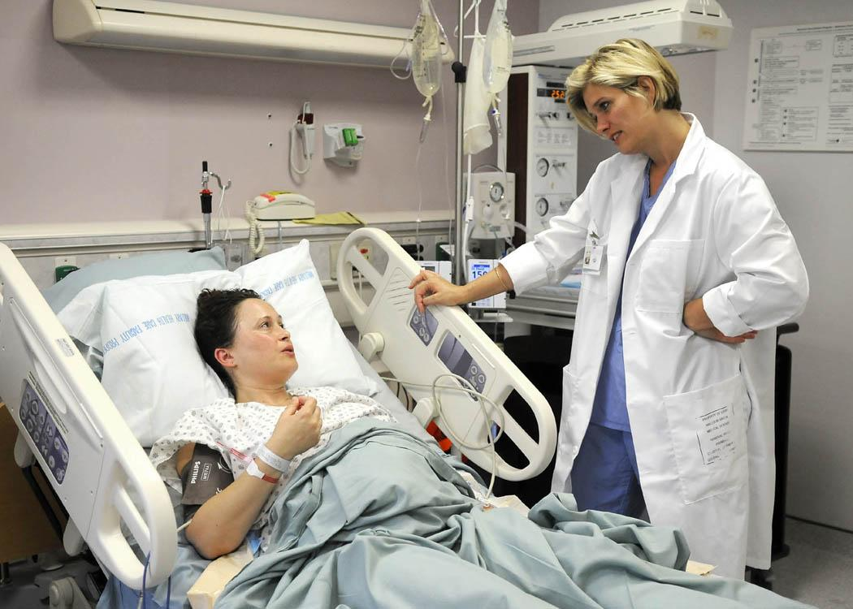
ROLE CARD 1: Hola, ¿qué tal?
LC — Hola, ¿qué tal? Soy _____. Soy su especialista de lactancia. ¿Cómo se llama usted?
Cliente — Hola. Soy Herlinda. Mucho gusto.
LC — Mucho gusto, Herlinda.
Cliente: El gusto es mío.

Slide 8
#2 way to be: ESTAR
Where and how am I? That IS the question ESTAR asks!
Let's conjugate the verb ESTAR together:
Yo estoy
Tú estás
Él, Ella, Usted está
Nosotros/as estamos
Ellos/as, ustedes están
Conjugate ESTAR many times until you can do it without looking! Conjugate with and without subject pronouns.

Slide 9
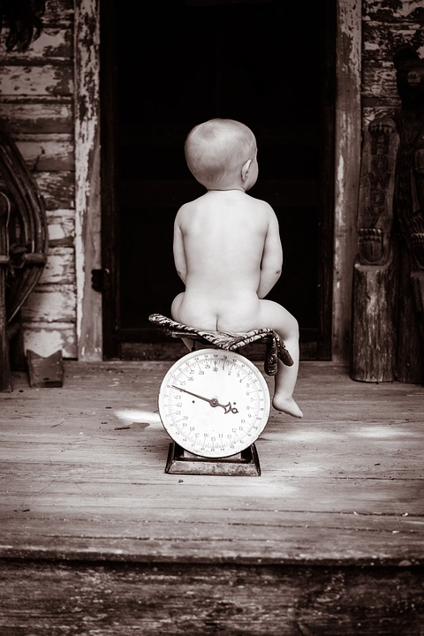
Some Examples With ESTAR
Location:
El bebé está en la báscula. (The baby is on the scale.)
Feelings:
Estoy bien. ¡Estoy contenta! (I am well. I am happy!)
Conditions, finished states:
La clase está terminada. (The class is finished.)

Slide 10
ESTAR = P.L.A.C.E.
Position – Mire donde está su cabeza. (Look where his/her head is.)
Location - La madre está acostada. (The mother is lying down.)
Action - Estoy amamantando mucho. (I am breastfeeding a lot.)
Condition -¿Cómo está usted? (How are you?)
Emotion - Estoy preocupada. (I am worried.)

Slide 11

Question: ¿Dónde?
Can you tell us where you are right now?
Estoy en…
La oficina (the office)
El hospital (the hospital)
La clínica (the clinic)
La casa (the house)
El dormitorio (the bedroom)
Someplace else?

Slide 12
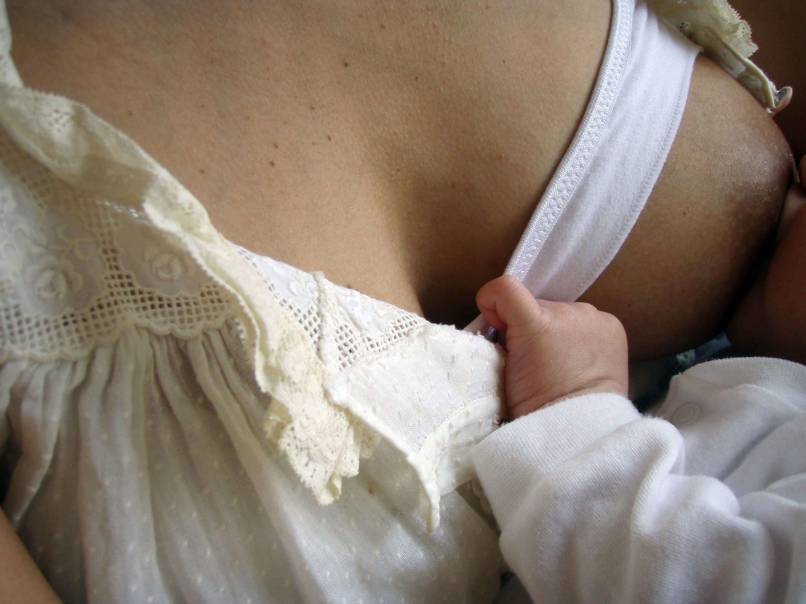
ROLE CARD 2: ¿Cómo está (usted) hoy?
LC — ¿Cómo está usted hoy, Señora García?
Cliente — Regular.
LC — Y la bebé, ¿cómo está ella?
Cliente — Ella tiene cólicos, y no duerme bien.
LC — Está bien. Enseñeme como usted amamanta en casa.

Slide 13
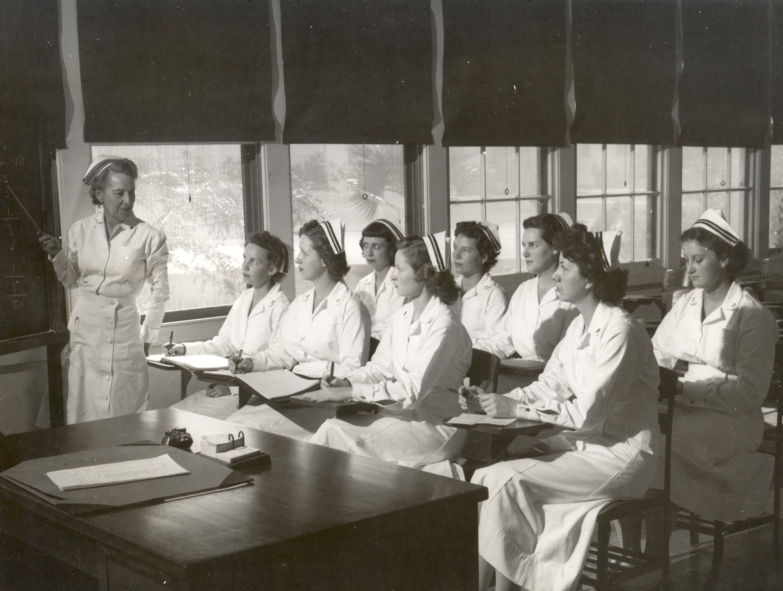
#3 (and last) way to be: Haber
The verb Haber is the most irregular and completely unique verb in Spanish. It has a conjugatable, personal form and an un-conjugatable impersonal form. We will work with the impersonal form now.
In the present tense Haber sounds like “eye” and is spelled “Hay”.
It means “there is” or “there are”.
¿Qué hay?
Hay muchas enfermeras.

Slide 14
¿Qué hay? (what is there?)
Hay otras madres como usted. (There are other mothers like you.)
Hay una bomba de hospital aquí para usted. (There is a hospital grade pump here for you.)
Hay muchos bebés con el frenillo corto. (There are a lot of tongue-tied babies.)
Hint: If you find yourself saying THERE is or are in English, it's HAY is the form of “to be” that you want in Spanish.

Slide 15
Hay for obligation.
Hay + que + infinitive of a verb = One must + verb
Examples:
Hay que relajarse (one must relax)
Hay que intentar (one must try)
Hay que ser paciente (one must be patient)
Hay que practicar. (one must practice)

Slide 16
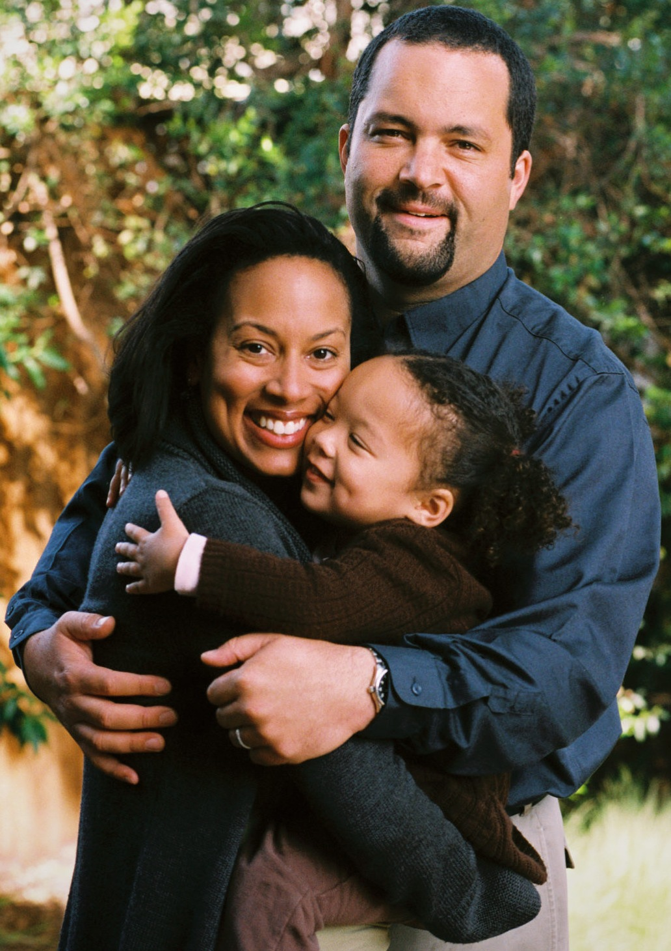
Role Card 3: Hay distracciones en casa
Cliente — Ai, doctora, mi bebé no sube de peso.
LC — ¿Come bien en casa?
Cliente — No sé. Hay muchas distracciones en casa. Tengo 4 hijos.
LC — Ya entiendo. Hay que tener un lugar privado para amamantar.

Slide 17
What do YOU want to say?
Right now: think of at least one time you would say “one has to/must _______ .”
LEARNING HINT: Always apply new language structure ideas to phrases you regularly say. With this structure and a dictionary, you can say a lot!

Slide 18
To Recap
There are 3 ways to talk about BEING in Spanish:
The verbs SER, ESTAR and HABER (HAY)
SER is about what is characteristic, or identifying about something or someone; also time.
ESTAR is about where and how something or someone is.
HAY is impersonal, and is about general existence: There is, there are. It can also be used to express obligation.

Slide 19
TRY YOUR SKILL:
Is it Ser, Estar or Hay?
1. Estoy / Soy / Hay la madre del niño. (I am the child's mother).
2.Está / Es / Hay enfermo el bebé. (The baby is ill.)
3. Está / Es / Hay suficiente leche. (There is enough milk.)
4. Están / Son / Hay adoloridos los pezones. (The nipples are painful.)
5. Está / Es / Hay interesante aprender el español.

Slide 20
Estoy / Soy / Hay la madre del niño. (I am the child's mother) - IDENTITY
Está / Es / Hay enfermo el bebé. (The baby is ill.) - CONDITION
Está / Es / Hay suficiente leche. (There is enough milk.) - GENERAL EXISTENCE
Están / Son / Hay adoloridos los pezones. (The nipples are painful.) - CONDITION
Está / Es / Hay interesante aprender el español. - CHARACTERISTIC
Answers

Slide 21

REMEMBER: ¡Práctica Hace al Maestro!*
PRACTICE MAKES PERFECT!
See you in class.
Nos vemos en la clase.
* Literally: “Practice Makes the Master.”

Slide 22
REMEMBER: ¡Práctica Hace al Maestro!*
PRACTICE MAKES PERFECT!
See you in class.
Nos vemos en la clase.
* Literally: “Practice Makes the Master.”

